Slide 1






PROJECT-P835
MANUFACTURING ANALYTICS
14.04.25

Slide 2
PROJECT TEAM MEMBERS
Swajal Sandeep Aparadh
Amrit Pritam
Tirumandyam Soma Sekhar Reddy
V.Saketh Reddy
Prabhuprasad Karmi

Slide 3
OVERVIEW
Goal: Create an Interactive Dashboard
Tools used: MS Excel, Power BI, Tableau Public, MySQL
Current Status: Dashboard Completed

Slide 4
DATASETS DESC.
Summary: This dataset tracks end-to-end manufacturing operations, including:
Customer & Sales Orders | Buyer details, delivery timelines (e.g., Cust Code, SO Delivery Date, SAP So Num).
Production Workflows | Work orders, machines, operations, and quality metrics (e.g., WO Number, Operation Code, Rejected Qty).
Employee & Machine Allocation | Workforce assignments, shift codes, and machine performance (e.g., Emp Name, Machine Code, Shift Code).
Inventory & Output | Quantities produced, shortages, and balances (e.g., Manufactured Qty, Balance Qty, Shortages).
Financial Tracking | Costs, revenue, and fiscal dates (e.g., Per day Machine Cost, TotalValue, Fiscal Year).
System & Metadata | Document numbers, timestamps, and technical identifiers (e.g., Doc Num, Fiscal DateTime, User Id).

Slide 5
KPIS
Manufacture Qty
Rejected Qty
Processed Qty
Wastage Qty
Employee Wise Rejected Qty
6. Machine Wise Rejected Qty
7. Production Comparison trend
8. Manufacture Vs Rejected
9. Department Wise Manufacture
Vs Rejected
10. Emp Wise Rejected Qty

Slide 6
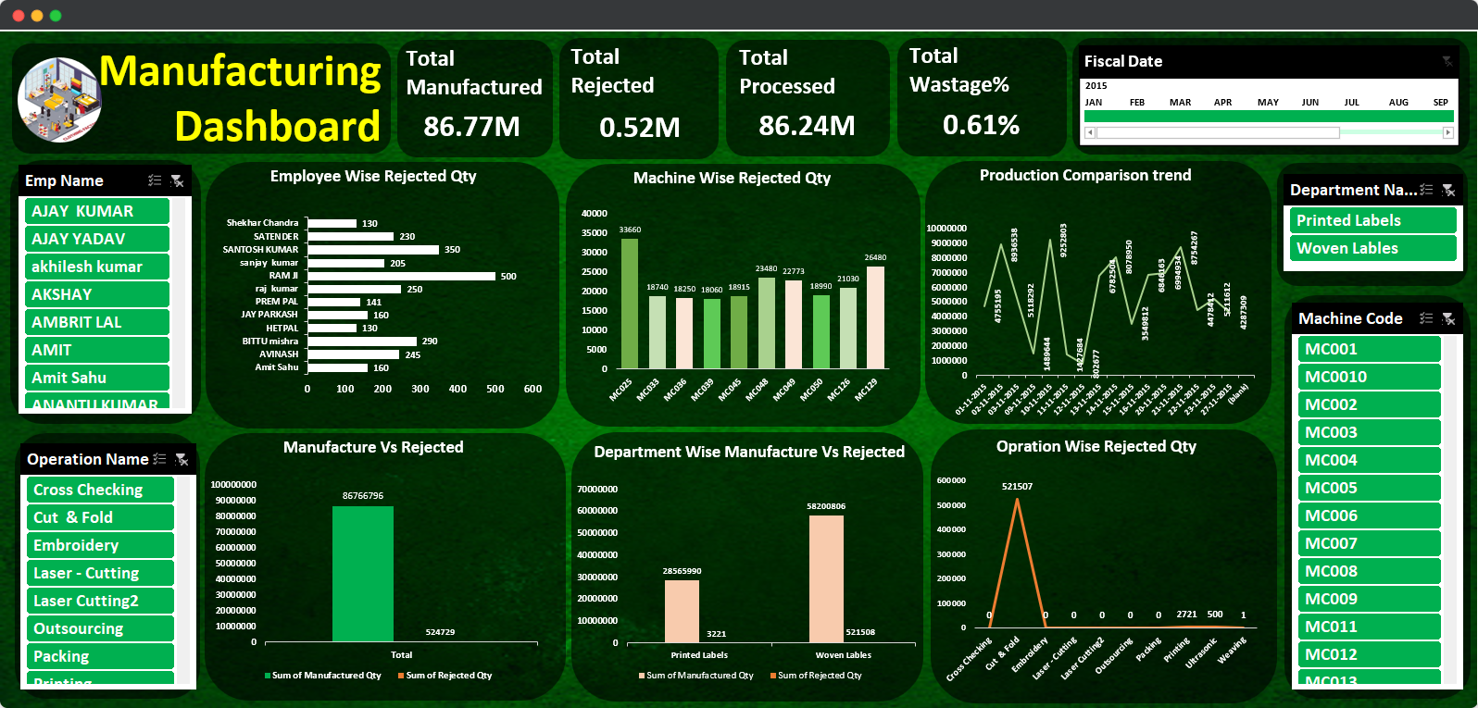
MS EXCEL DASHBOARD

Slide 7
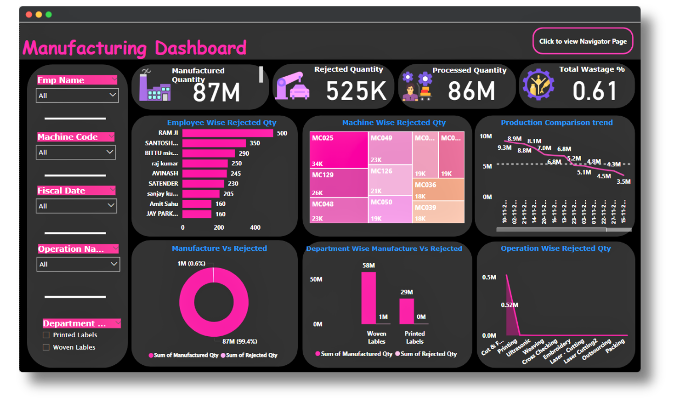
POWER BI DASHBOARD

Slide 8
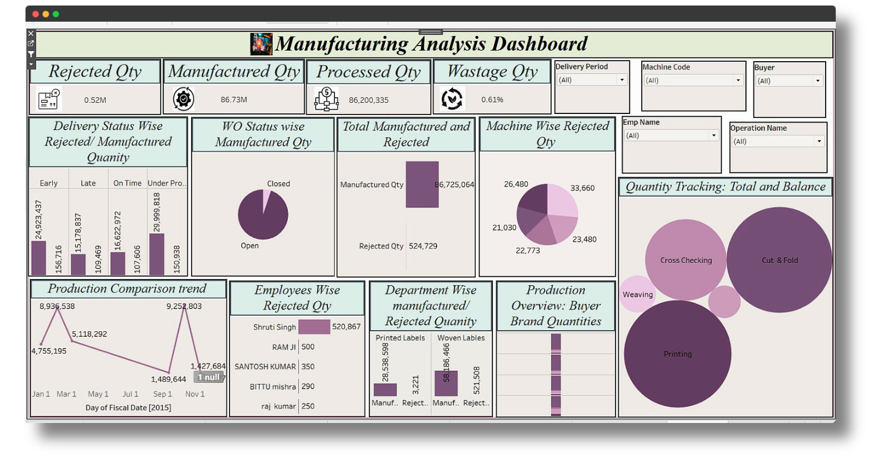
TABLEAU DASHBOARD

Slide 9
CONCLUSION
Manufacture Qty: Monitor production volumes for resource planning.
Rejected Qty: Track defects to improve quality and reduce waste.
Processed Qty: Measure throughput to optimize efficiency.
Wastage Qty: Identify material inefficiencies to cut costs.
Employee-Wise Rejects: Pinpoint training needs to reduce errors.

Slide 10
CONCLUSION
6. Machine-Wise Rejects: Schedule maintenance to boost machine
efficiency.
7. Production Trends: Compare data over time to adjust schedules.
8. Manufacture vs. Rejects: Balance output and quality for process
improvements.
9. Dept-Wise Comparison: Allocate resources based on department
performance.
10. Operation-Wise Rejects: Target bottlenecks to enhance workflow.

Slide 11
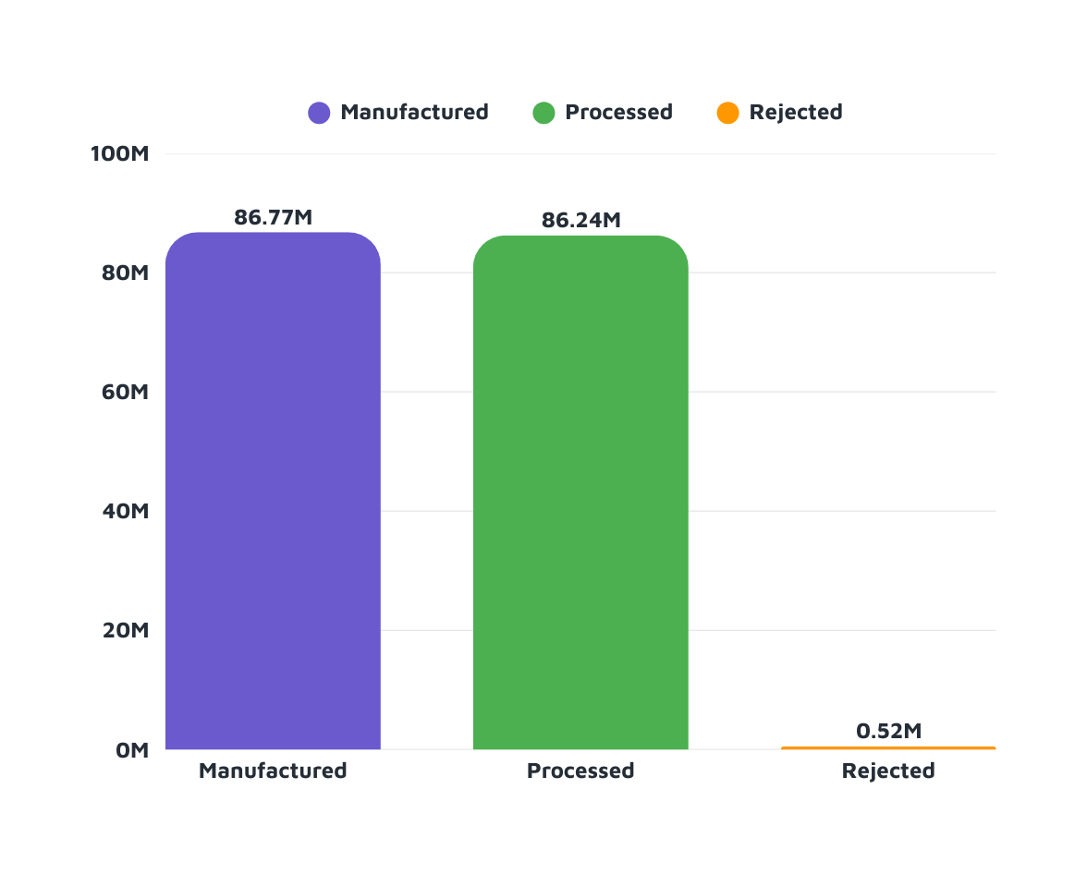

RESULT

Slide 12
Thank You

